Slide 1
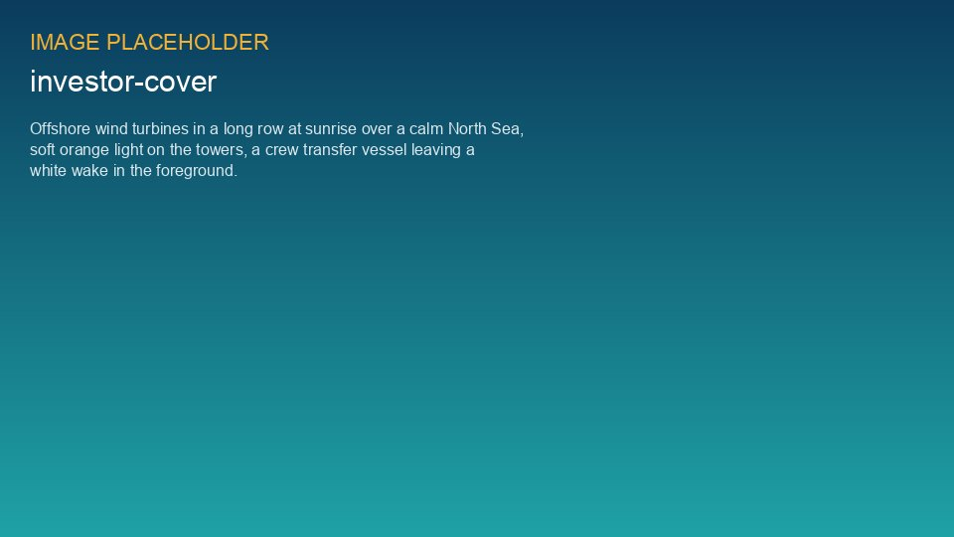
WEYLAND ENERGY
Weyland Energy
Investor presentation 2026 · Clean power, built to last.

Slide 2
Weyland at a glance
1.1 GW
4.2 GW
EUR 312 m
1.2 Mt
in operation
pipeline
revenue 2025
CO₂ avoided 2025
• Founded 2011 in Hamburg; 450 people in Hamburg, Edinburgh and Copenhagen
• Wind, solar and storage in Germany, the UK and Denmark
WEYLAND ENERGY · Investor Presentation 2026
2

Slide 3
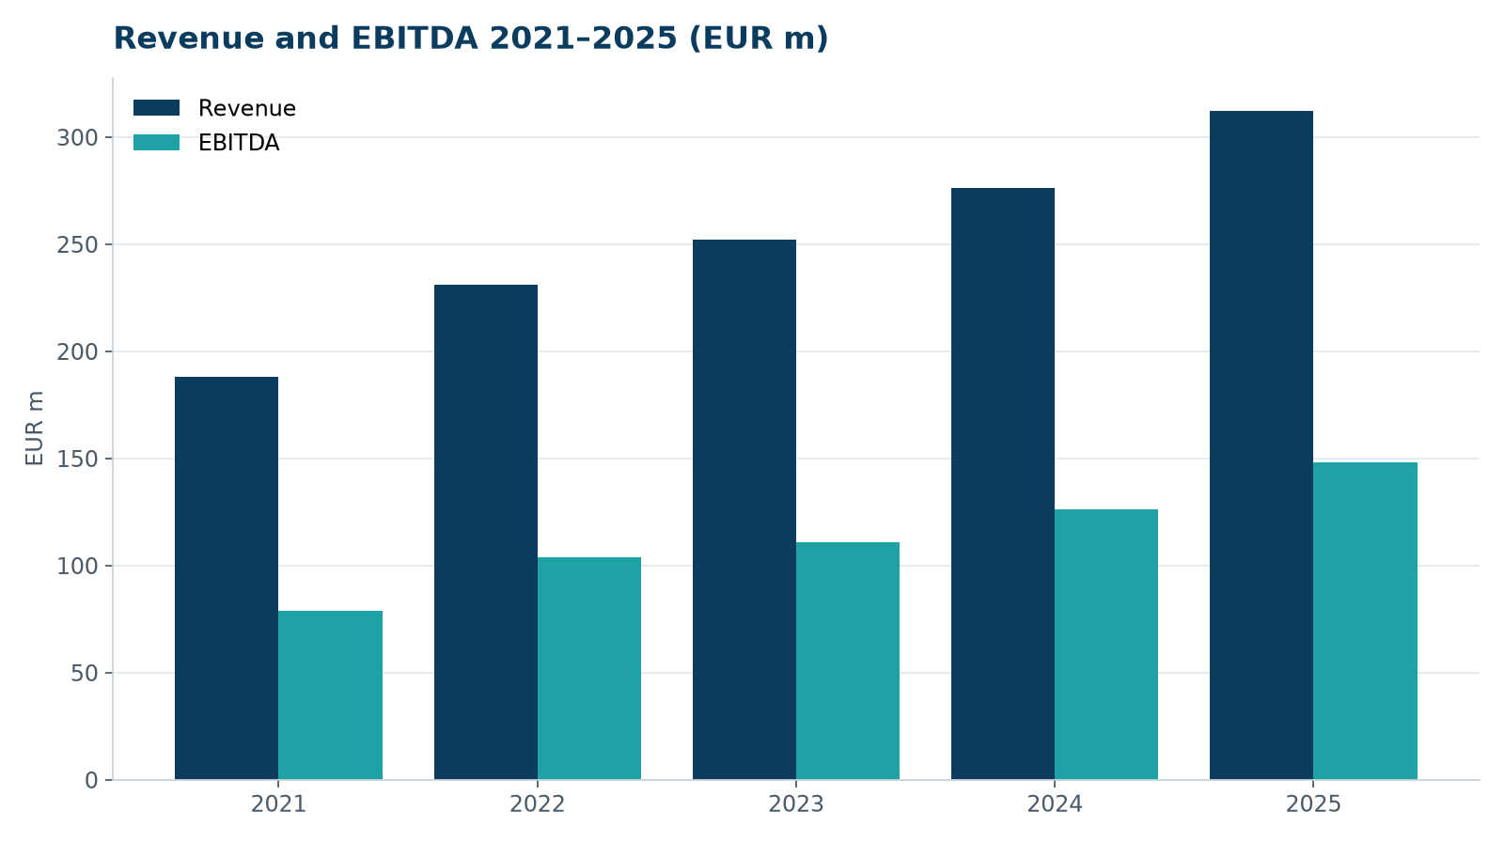
Strong growth track record
• Revenue CAGR 2021–2025: 13.5 %
• EBITDA margin 47 % in 2025
• Operating cash flow EUR 131 m in 2025
WEYLAND ENERGY · Investor Presentation 2026
3

Slide 4
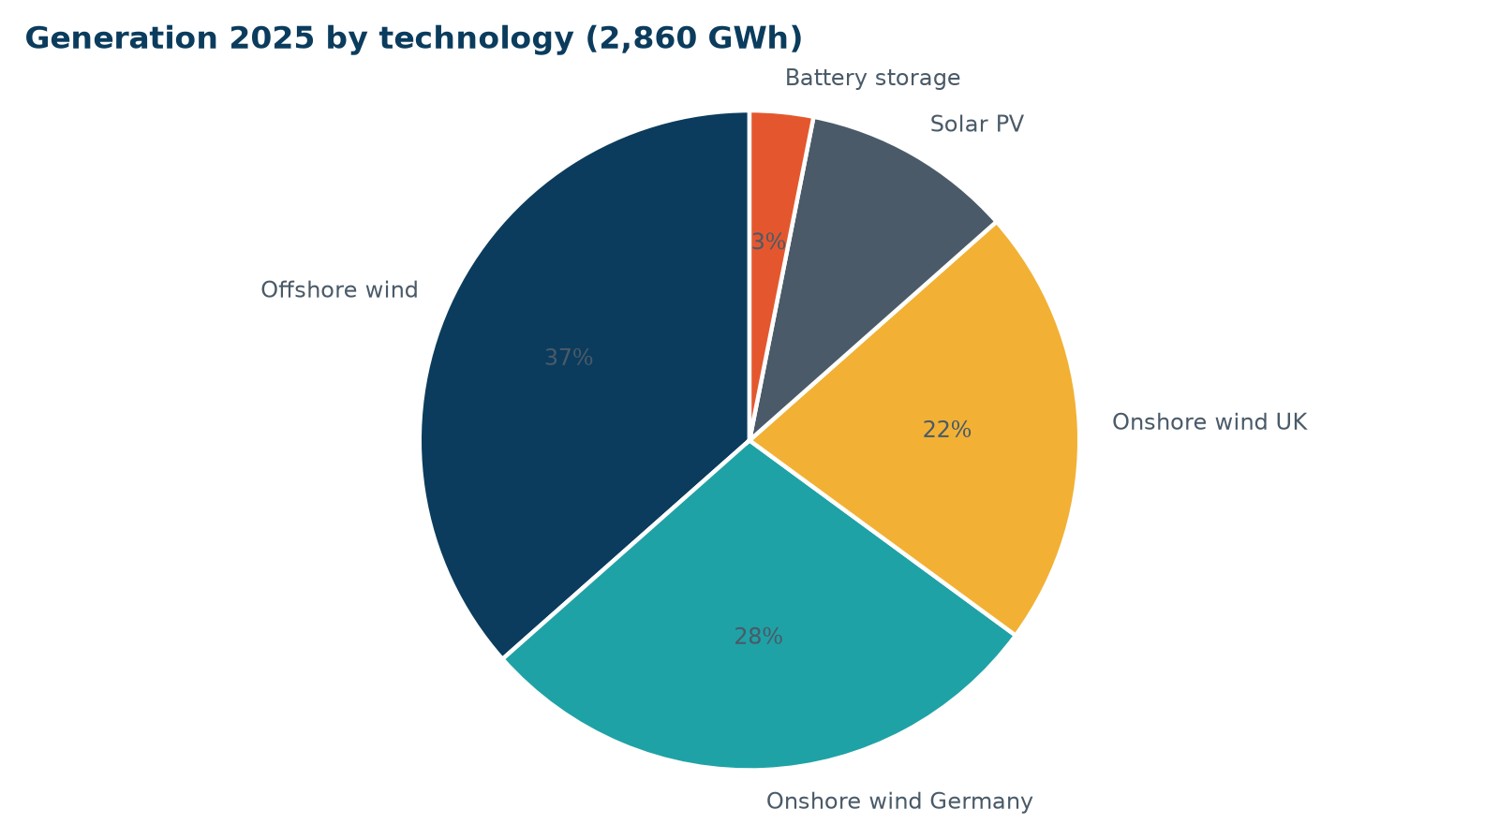
Diversified generation
• 2,860 GWh generated in 2025
• 64 % of revenue contracted long-term
• Kestrel Ridge availability 97.4 %
WEYLAND ENERGY · Investor Presentation 2026
4

Slide 5
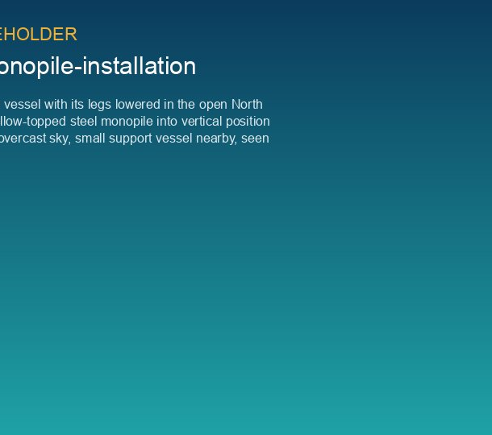
Harrow Bay Offshore Wind
• 480 MW, 40 × Halden HTS-12
• FID and financial close 12 Feb 2026
• EUR 1.62 bn capex, EUR 1.1 bn senior debt
• 12 of 40 monopiles installed by end of August 2026
• COD planned 30 June 2028
WEYLAND ENERGY · Investor Presentation 2026
5
Notes:
Mention HB-RISK-017 proactively: export cable 2 re-manufacture, COD maintained, float now 6 weeks.

Slide 6
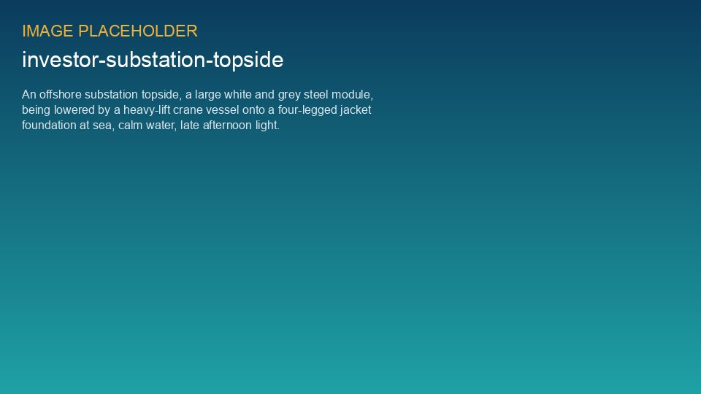
Offshore substation in place
HB-OSS topside installed on 19 August 2026

Slide 7
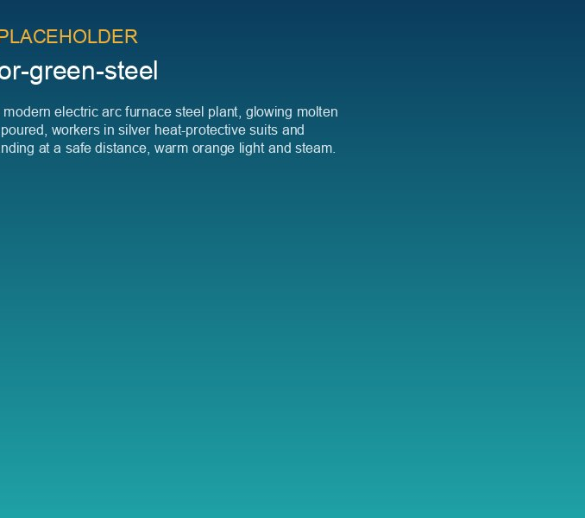
PPA with Arcturus Steel
• WE-PPA-2026-004 signed 12 May 2026
• 15 years, 150 MW pay-as-produced
• ~590 GWh per year for green steel production
• Partner in the 5 MW Green Hydrogen Pilot
WEYLAND ENERGY · Investor Presentation 2026
7

Slide 8
Strategy 2030
2.5 GW
EUR 600 m
≥ 45 %
≤ 6.0x
operating capacity 2030
revenue 2030
EBITDA margin
net debt / EBITDA after COD
WEYLAND ENERGY · Investor Presentation 2026
8

Slide 9
ESG leadership
• ESG rating 88/100, 4 stars (peer average 79)
• 96 % taxonomy-aligned revenue
• ISO 9001, 14001, 45001 – ISO 27001 in Q2 2027
• 20 % biodiversity net gain at Millbrook
WEYLAND ENERGY · Investor Presentation 2026
9

Slide 10
Why Weyland
• Proven operator with a de-risked growth project
• Long-term contracted revenues with industrial offtakers
• Disciplined capital allocation and capital recycling
• Committed long-term shareholders
WEYLAND ENERGY · Investor Presentation 2026
10

Slide 11
WEYLAND ENERGY
Contact
Fiona Campbell, Investor Relations · ir@weyland-energy.example

